Slide 1


Slide 2


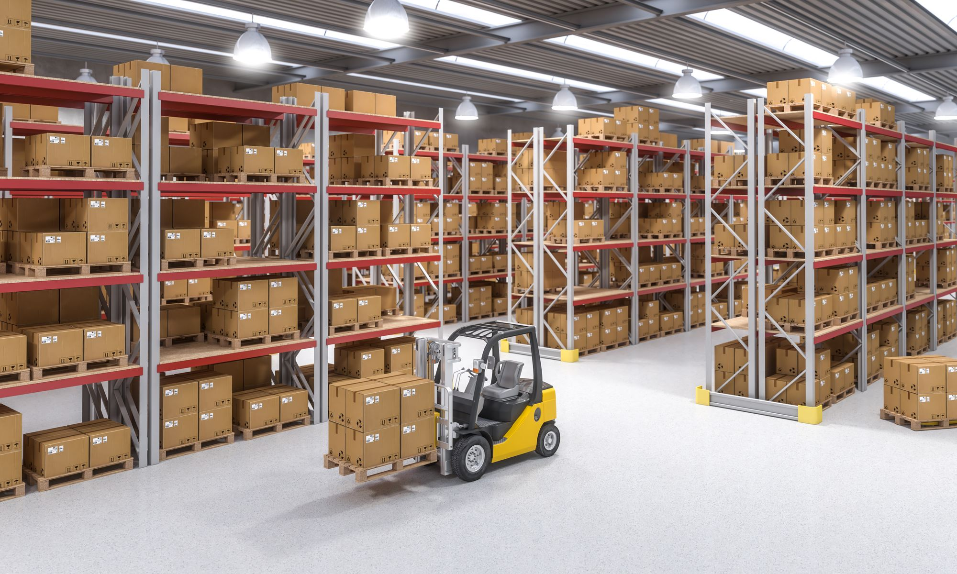



INTRODUCING We do Logistics
We are a fast-growing freight forwarder with a global network that is rapidly expanding.
Digitally focused on serving customers both large and small with a full range of products and services.
Our experienced teams are ready to support and handle all your shipments.
We are focused on becoming the agile leader in emerging markets logistics.

Slide 3
OUR FUNDAMENTAL PRINCIPLES
Our vision:
To be a bold and forward-looking trade enabler of choice.
Our mission:
Continually innovate and improve as a trade enabler to meet and exceed our customer’s needs.
Our values:
Trustworthy & accountable
Reliable service
Always improving
Duty of care
Energized teamwork

Slide 4

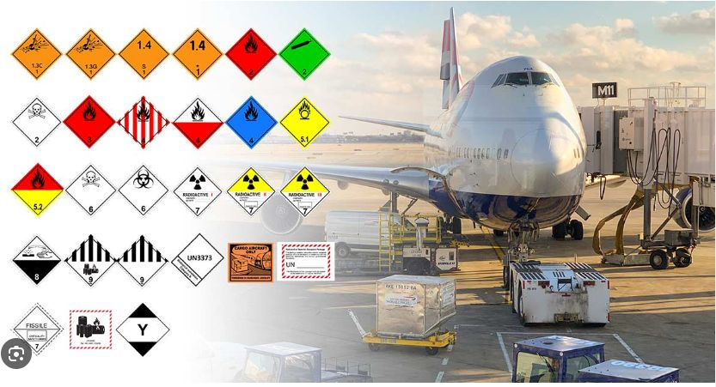
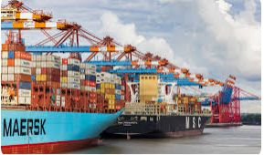
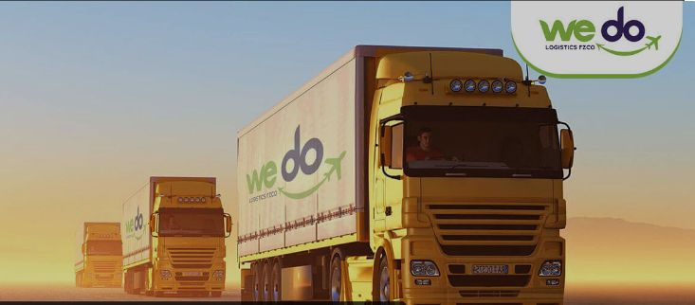

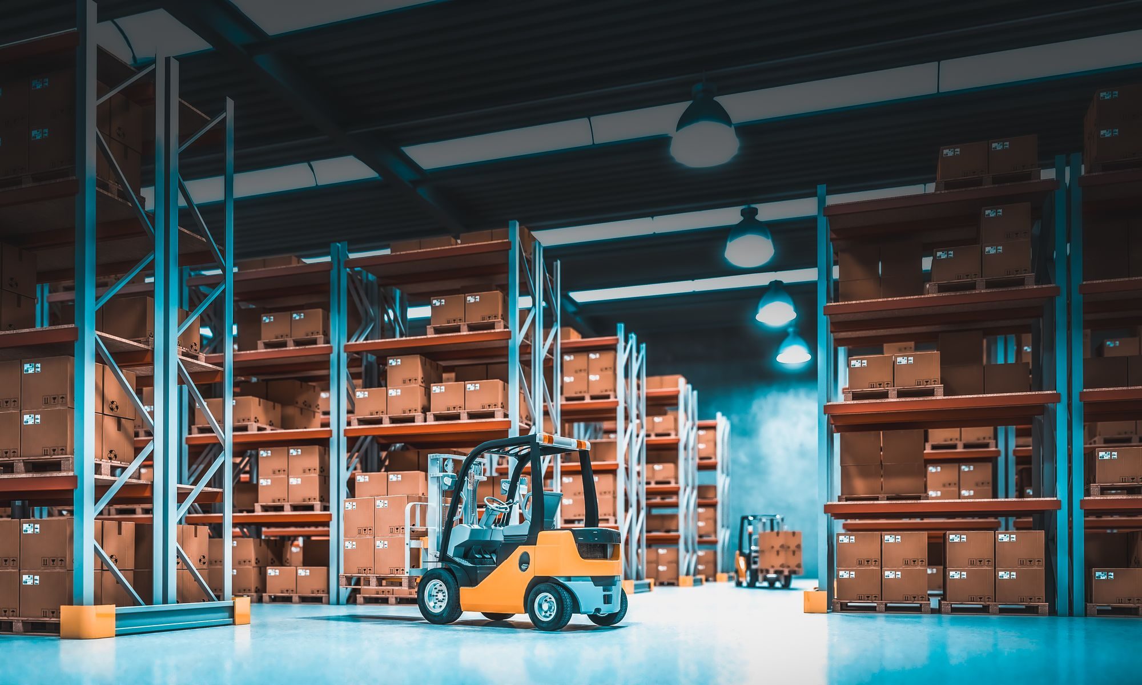
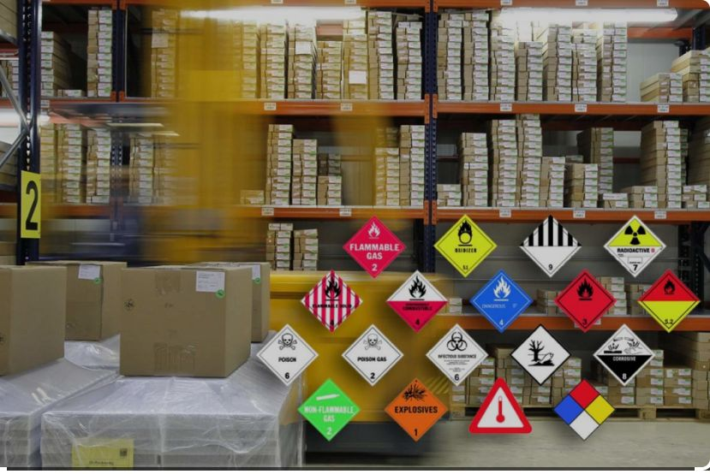

OUR SERVICES
INTERNATIONAL AIR FREIGHT
OCEAN FREIGHT
ROAD TRANSPORT
CUSTOMS CLEARANCE
WAREHOUSING
DANGEROUS GOODS HANDLING
YOUR END-TO-END LOGISTICS
SOLUTIONS PROVIDER

Slide 5
International Air Freight
Our Air Freight Services are carefully crafted to cater to all your air transportation needs, our range of highly flexible and customizable products allows you to create unlimited possibilities to expand your supply chain. With our personalized services coupled with pre-allocated space and strategic service locations you are guaranteed to optimize your supply chain at the most competitive prices.
Our team is continuously striving to create unmatched customer experience offering a hassle-free end to end service. Starting with most convenient pickup, professional handling, fully equipped customs bonded warehousing facilities together with endless air freight connectivity options will put you ahead of your competition.

Slide 6
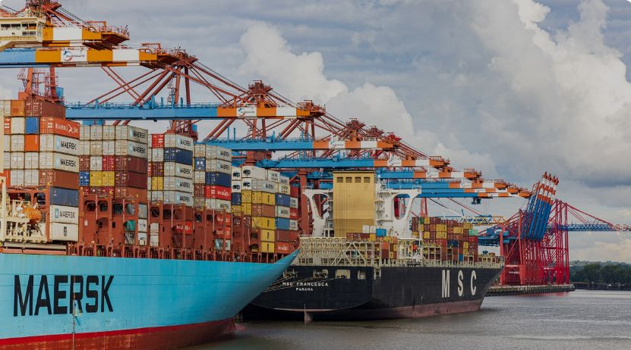
International Ocean Freight
Working in tandem with some of the world’s leading shipping lines, we do Logistics Cargo’s Ocean freight services cover all major global markets, with an emphasis on developing new trade lanes.
Our strength is in offering our customers tailor-made solutions, with the best available schedules and transit times at competitive prices. We are capable of handling consignments of any size, with an assurance of expert handling by a team of experienced professionals

Slide 7
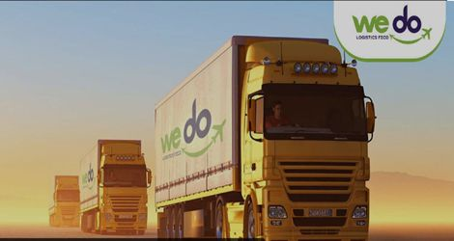
Road Transport
We do Logistics Cargo’s overland transportation services are customized to deliver reliable and on-time solutions – every time. Our exhaustive fleet of vehicles are available 24/7/365, and guarantees the quickest turnaround times to meet our customers business requirements.
In collaboration with our extensive network of reliable partners spread across the GCC countries and worldwide, we offer a comprehensive Door-to-Door or Door-to-Port Road Haulage service to cater to our customers distribution needs, while taking care of all the tedious customs and border formalities giving our customers peace of mind. We will provide you with the best advice and complete information on the various documentation requirements at each border/point of entry in to/out of any of the GCC countries as well as overseas destinations, offering our customers a one-stop-shop for cost efficient overland transport solutions.

Slide 8

Customs Clearance
Customs clearance forms an essential part of the time-critical transport and logistics industries globally. To support our customers, our network of global customs experts, with local expertise of their respective countries play a crucial part in the seamless processes of our customers supply chains world-wide.
Customs processes are even more critical in the U.A.E. given the ideal geographical location that positions the country as a transshipment hub in the middle of many trade-lanes. This not only supports commerce in general, but the transport and logistics industries which form a crucial part of the economy.
We do Logistics Cargo is a fully licensed Customs Broker in the U.A.E. represented at all Air, Sea, and Land Border points; geared to offer various types of customs clearances to its customers across various industry segments. Our fully fledged team of well-trained and experienced staff are competent in all local regulations pertaining to imports and exports of all types of goods from various parts of the world in to the and out of the UAE. From straight-forward import and export clearances to multi-model shipment clearances, our experts can provide the best advice at the right time to meet our customer’s strict delivery and clearance schedules

Slide 9
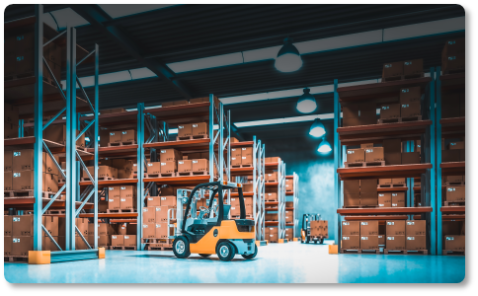
Warehousing and Distribution
We do Logistics Cargo manages warehousing facilities within DAFZA UAE, with all the facilities equipped with the latest machinery which allows the efficient management of various aspects of the supply chain requirements of our customers.
Staffed with a team of highly experienced professionals, well versed and trained in complete aspects of warehouse management, all our services are offered with complete security of our customers’ inventory against threats of fire, pilferage, damage etc., giving our customers complete peace of mind.

Slide 10
Dangerous Goods Handling
As a fully licensed and approved Dangerous Goods handler, we do Logistics Cargo has its own dedicated DG handling area within its warehouse confines, equipped with an expert team of dedicated and highly qualified DG personnel to handle all its customers DG requirements.
These facility is extended in view of providing timely handling of all DG shipments. The service offerings include repackaging of DG shipments as per IATA DG regulations for Air shipments, and IMO regulations for Ocean shipments and cover any and all DG or Hazardous materials classified commodities.

Slide 11


CONNECTING YOU GLOBALLY
Having our partners in strategic countries enables us to have complete control of operations while delivering end -to-end service to our customers.
We continue to expand our global footprint, with a focus on emerging markets.

Slide 12
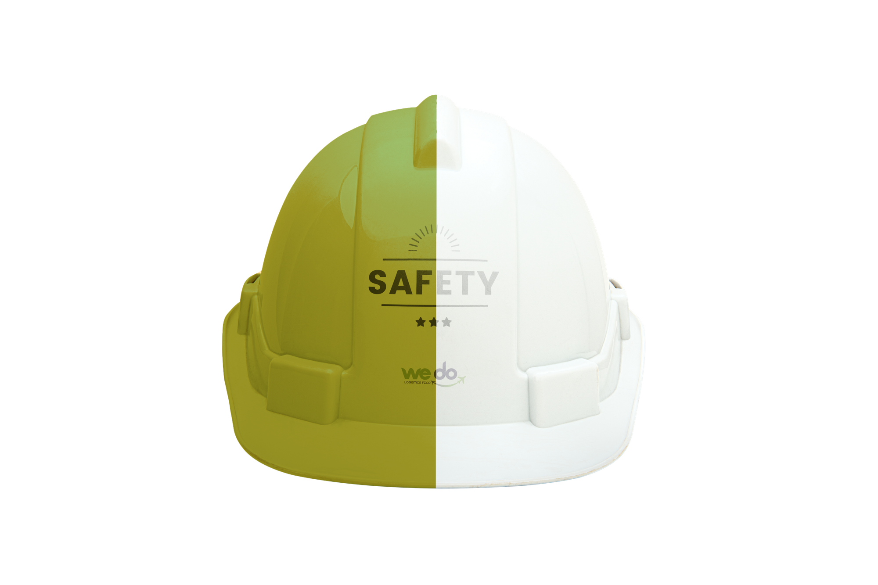
DEDICATED TO QUALITY, HEALTH, SAFETY, & THE ENVIRONMENT
A global approach to Quality, Health, Safety, and the Environment (QHSE) is at the forefront of our business.
We aim to safeguard the health and safety of every employee, customer, and partner.
We take all the necessary measures to ensure that everyone is aware of the responsibility to themselves, to their colleagues, and to the environment.
Our minimum standard is to comply with all national applicable laws.
We also train, where appropriate, partners and contractors to reduce risk to all.

Slide 13

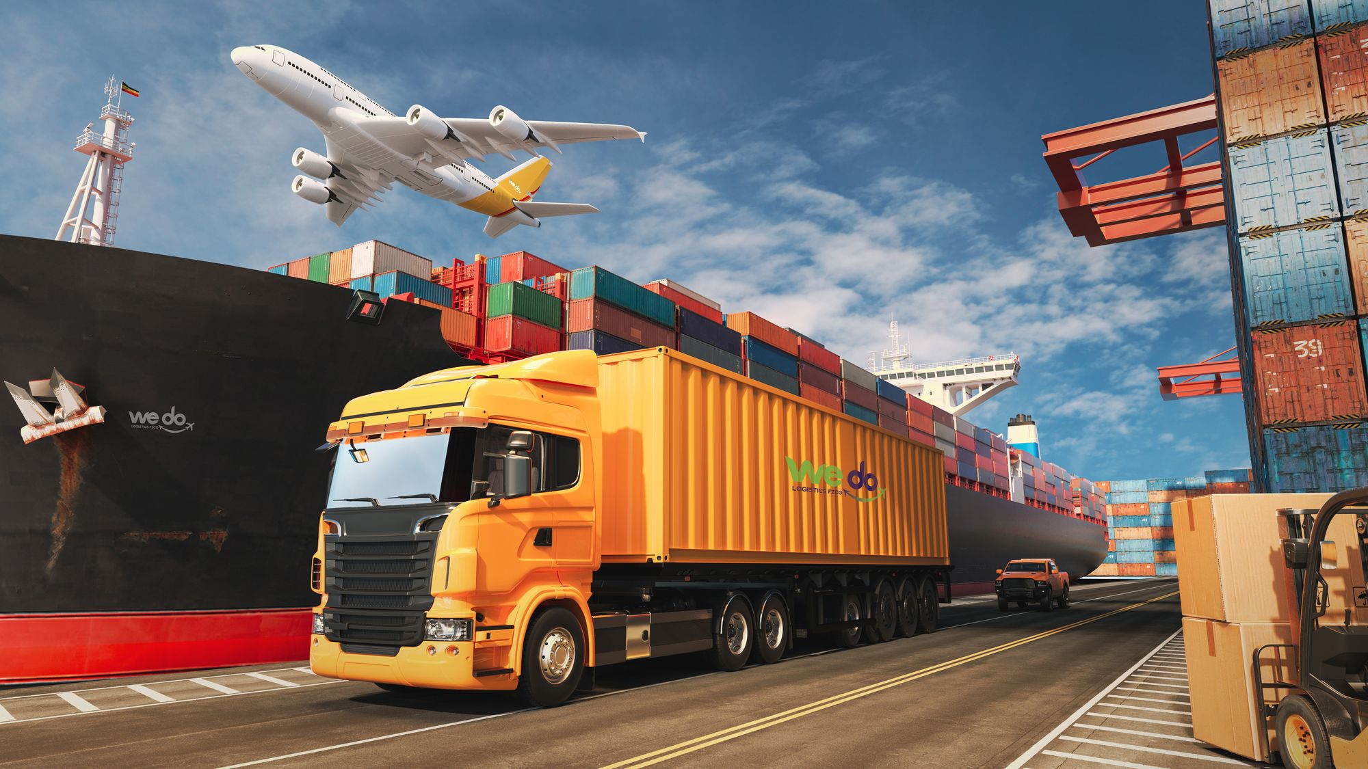
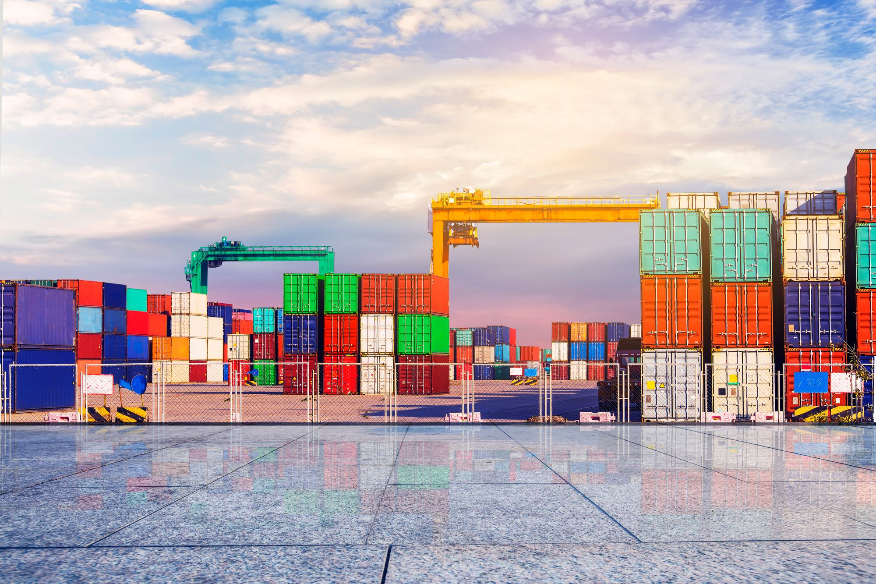
OUR CORPORATE SOCIAL RESPONSIBILITY
Our corporate social responsibility (CSR) activities are based on two main themes:
  Sustainability in Logistics
  Supporting our Communities
Our global team works with key stakeholders and partners to ensure that sustainability in logistics is a focus topic and that we all work together to make logistics more sustainable.
Our country organizations work closely with their communities to help drive positive changes in the areas of education, equality, and sustainability.

Slide 14
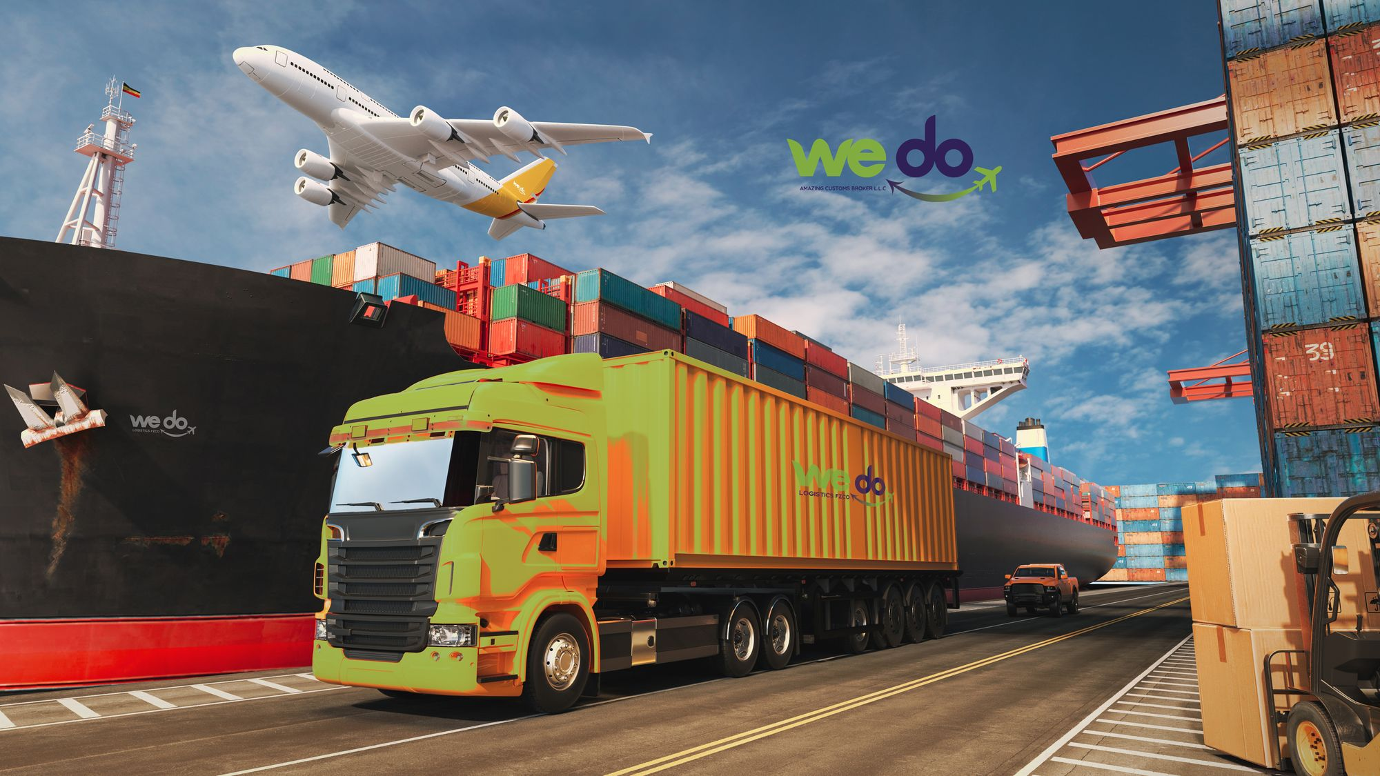
WHY CHOOSE we do Logistics?
At We do Logistics , we offer tailored and flexible solutions while focusing on efficiency and cost benefits.
Whether you are seeking domestic or international logistics services, our dedicated and well-experienced professionals will give you peace of mind by managing all aspects of your logistics needs.
Exceeding the expectations of our customers is the benchmark of our success and we consistently seek to deliver solutions that add value to their activities.
We are focused on becoming the agile leader in emerging markets logistics.
Subject matter experts
• Local expertise, global network
• Competitive, complete rates
• One point of contact
• Customer focused
• Highly experienced team
• Service commitment
• Enhanced supply chain network`

